Slide 1
Migration and Visual Upgrade
Updating SP 2007 Branding Efforts for SP 2010
Notes:
This lecture takes a deep dive into the internals of the Visual Upgrade feature of SharePoint 2010 to provide a solid understanding of what happens when migrated sites run in either of the two supported user interface modes. The lecture begins by discussing the critical aspects of the SharePoint 2007 user interface that are carried forward to SharePoint 2010 so that migrated sites can continue to run using the older 2007 user interface. The lecture also discusses how to migrated sites can be upgraded to use the new user interface mode and goes into detail about exactly what happens behind the scenes when switching from one mode to another. Emphasis in this lecture is given to teaching Web designers and developers what is required when updating SharePoint 2007 branding project and migrating custom content to the SharePoint 2010 environment.

Slide 2
Agenda
Motivation for Visual Upgrade
The Mechanics of Visual Upgrade
Updating Branding Assets for SharePoint 2010

Slide 3
Motivation for Visual Upgrade
SharePoint 2010 UI much improved over 2007 UI
Eliminates unnecessary postbacks
Eliminates confusing page transitions
Eliminates table-based page layouts
User experience (UX) in 2010 very different
Links and buttons are now moved into ribbon tabs
Common tasks are now dialog box–driven
Users migrating to SharePoint 2010 require training
Pages customized for 2007 might look bad in 2010 UI
Notes:
The user interface of SharePoint 2010 is a clear and welcome departure from the user interface provided by Windows SharePoint Services 3.0 (WSS) and Office SharePoint Server 2007 (MOSS). The new SharePoint 2010 user interface leaves behind many of the unnecessary postbacks, the confusing page transitions, and the table-based page layouts of the previous version. The result is a much improved user experience that includes a server-side ribbon and new client-side behavior that executes standard user commands behind the scenes by using asynchronous callbacks to the web server.
Although the advancements to the SharePoint 2010 user interface represent a great step forward, one must also acknowledge that the new user experience is very different from that of WSS and MOSS. The links and buttons for standard user commands live in new places behind ribbon tabs. The user experience for executing many common tasks is now dialog box–driven and might take some time to become familiar with. Although the new user interface has obvious long-term benefit, it can also have a short-term effect on user productivity. Therefore, companies should carefully plan their migration to the new user interface of SharePoint 2010 and this migration should involve some end-user training.

Slide 4
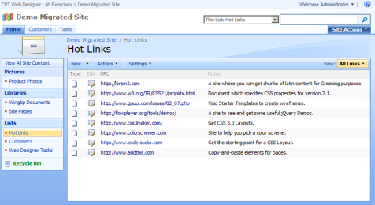
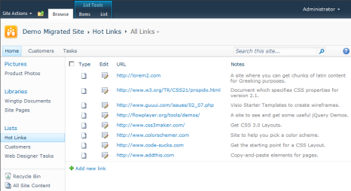
What Is Visual Upgrade?
A migration feature built into SharePoint 2010
Used with sites migrated from SP 2007 to SP 2010
Allows sites in 2010 farms to run under 2007 UI mode
It decouples content migration from UI migration
Farm admin can migrate site content to SP 2010 today
UI can be upgraded any time on a site-by-site basis
Users can upgrade the UI at time that is best for them
SharePoint 2007 Farm
SharePoint 2010 Farm
Content Migration
User
Interface
Migration
Notes:
SharePoint 2010 provides Visual Upgrade, which is designed to assist companies that are upgrading their existing sites to run in a SharePoint 2010 environment. The key value of Visual Upgrade is that it enables companies to upgrade sites to SharePoint 2010 without forcing their users to immediately begin using the new SharePoint 2010 user interface. Instead, Visual Upgrade enables users to continue using the older familiar interface within a SharePoint 2010 farm during a period of transition. At some point in the future when the users are ready for the change, the site administrator can reconfigure the site to begin using the new SharePoint 2010 user interface.
The core value of the Visual Upgrade feature is that it effectively decouples the migration of sites and content from the end users' migration to the new SharePoint 2010 user interface. This enables the farm administrator to migrate sites and content to SharePoint 2010 without having to worry about coordinating end-user training in advance. Visual Upgrade also makes it unnecessary to prematurely force business users to begin using the new SharePoint 2010 user interface, no matter which weekend the farm administrator choses to perform the upgrade.

Slide 5
Agenda
Motivation for Visual Upgrade
The Mechanics of Visual Upgrade
Updating Branding Assets for SharePoint 2010

Slide 6
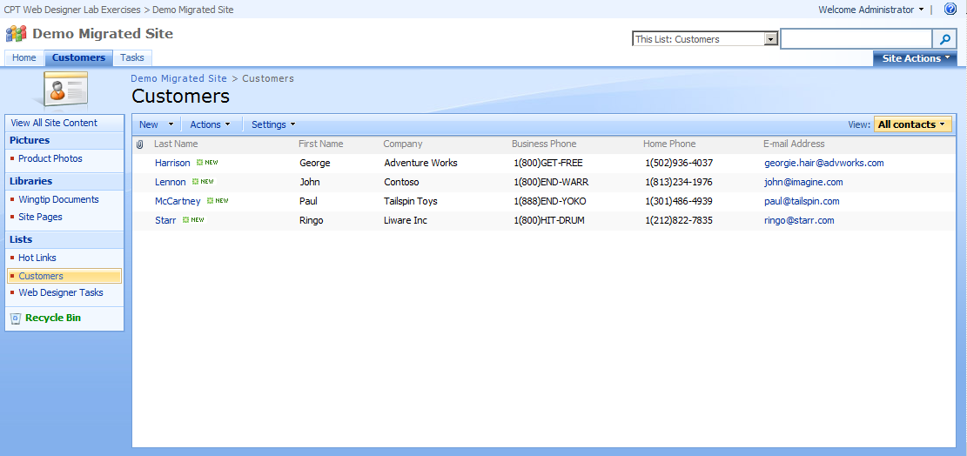
The SharePoint 2007 User Interface
SharePoint 2007 UI is based on default.master
Contains CssLink control which links to core.css
Does not include a DOCTYPE
Pages render in quirks mode
Notes:
To understand the inner workings of Visual Upgrade, it is necessary to conduct a quick review of the standard user interface components that are used in WSS. Whenever WSS provisions a new site, it creates a master page gallery. In addition to creating the master page gallery in each new site, it also provisions an instance of a master page named default.master, which is the primary master page in WSS that is used to give sites their standard look and feel.
The layout of the HTML elements defined within default.master is dependent upon rules inside cascading style sheets (.css files). The master page definition inside default.master includes a server-side control named CssLink, which automatically adds a link to an important file named core.css.
One very important point to consider is that default.master is defined without a DOCTYPE. The omission of a DOCTYPE in the pages of a WSS site forces browsers to interpret and render the HTML elements inside by using an older set of rules. It is equally important to acknowledge that the cascading style sheets rules behind HTML pages are also affected by the DOCTYPE, or in the case of WSS, by the lack of a DOCTYPE.
When a page does not define a DOCTYPE, the browser interprets the cascading style sheets rules behind it by using an older set of rules that many Web designers refer to as "quirks mode." It is called quirks mode because there is quite a bit of inconsistency in the way in which cascading style sheets rules are applied across browsers.

Slide 7

The ~masterurl/default.master Token
~masterurl/default.master introduced in SP 2007
Dynamic token used to swap out master page of site
Token values replaced using site's MasterUrl property
By default, MasterUrl property set to default.master
In SP 2007, token used by most out-of-box sites pages
In SP 2007, token cannot be used by application pages
Notes:
In WSS, site pages link to default.master by using a special token instead of a hardcoded path. More specifically, the Page directive in WSS site pages includes the MasterPageFile attribute, which is assigned the token value of ~masterurl/default.master, as shown in the code sample in the slide above.
The value of this special token is that it is dynamically replaced by WSS as it processes the page. Each WSS site has a MasterUrl property that is initially assigned a value that references the instance of default.master in the current site's master page gallery. However, a custom solution can upload a custom master page to the master page gallery and update the MasterUrl property to redirect site pages to use the custom master page instead of default.master.
An important point regarding master pages and application pages is that WSS and MOSS do not support linking application pages to default.master or to any other master page in a site's master page gallery. Instead, application pages are written to link to master pages that are deployed inside the LAYOUTS directory. For example, the majority of application pages that are supplied by WSS and MOSS link to the standard master page named application.master, which is deployed inside the LAYOUTS directory.

Slide 8
SharePoint 2010 Supports Two UI Versions
Version 3 identifies Mode for SharePoint 2007
default.master
application.master
core.css
Version 4 identifies Mode for SharePoint 2010 UI
v4.master
corev4.css
Notes:
The new user interface in SharePoint 2010 has been rebuilt from the ground up. Therefore, it uses new master pages and new .css files that were not included with WSS or MOSS. However, to provide the functionality that is required for Visual Upgrade, SharePoint Foundation 2010 must also carry forward the same standard master pages and .css files that are used in WSS. Therefore, SharePoint Foundation 2010 deploys several files that have the same names as they do in WSS, such as default.master, application.master, and core.css.
To differentiate between the older files that are created for WSS and the newer files that are created for SharePoint Foundation 2010, Microsoft created a simple versioning scheme. The user interface of WSS and MOSS is named version 3 because WSS carries the version number of 3.0. The new user interface of SharePoint 2010 is named version 4. As you will see, some files that are included with SharePoint Foundation 2010 have either a v3 or a v4 in their name to indicate which version of the user interface they are designed to support.
Whenever SharePoint 2010 provisions a new site, it creates the master page gallery and provisions a master page named default.master, just like WSS. However, SharePoint 2010 provisions two additional master pages named v4.master and minimal.master.
The master page named v4.master is the primary master page that is used to construct the new SharePoint 2010 user interface. For example, v4.master is what gives team sites in SharePoint 2010 a common page layout across all the pages in a site, including familiar elements such as the Site Actions menu, the breadcrumb trail, the ribbon, the Welcome menu, the Site Icon, the TopNav bar, and the QuickLaunch.

Slide 9
The Inner Mechanics of Visual Upgrade
The site (SPWeb) has a UIVersion property
When UIVersion equals 3, sites runs with 2007 UI
When UIVersion equals 4, sites runs with 2010 UI
When site is running with UIVersion equal to 3
MasterUrl property has default value of default.master
CssLink control adds link to core.css
When site is running with UIVersion equal to 4
MasterUrl has default value of v4.master
CssLink adds link to corev4.css
Notes:
By default, when a WSS site or an MOSS site is upgraded to SharePoint 2010, its pages are initially rendered by using the version 3 user interface of WSS. However, the choice of when to migrate the user interface to version 4 can be made by site administrators on a site-by-site basis by using standard commands in the browser. There is also a command available in the browser for a site collection owner to migrate all the sites within a site collection at one time. This means that individual teams can decide when the time is right for them to migrate the user interface of their sites to version 4.
Each SharePoint site is represented by an SPWeb object. Starting with SharePoint 2010, each SPWeb object carries a new UIVersion property that is tracked in the content database. The UIVersion property is integer-based and can have a valid value of either 3 or 4. When a site has a UIVersion property value of 3, SharePoint 2010 will render the site's pages by using version 3. When a site has a UIVersion property value of 4, SharePoint 2010 will render the site's pages by using version 4.
When a new site is created in SharePoint 2010, the UIVersion property is assigned a value of 4 and no trace of the SharePoint 2007 is ever seen by the user. Therefore, all aspects of Visual Upgrade really only concern sites migrated from SharePoint 2007 but never new sites created in a SharePoint 2010 farm.

Slide 10
DocTypes and SharePoint
SharePoint 2007 pages have no DocType
default.master does not define a DOCTYPE
Pages render in quirks mode
SharePoint 2010 pages use XHTML Strict 1.0
v4.master defined with this DOCTYPE
<!DOCTYPE html PUBLIC "-//W3C//DTD XHTML 1.0 Strict//EN"
"http://www.w3.org/TR/xhtml1/DTD/xhtml1-strict.dtd">
Notes:
The SharePoint 2007 master page named default.master does not define a DOCTYPE. This means that pages in a SharePoint 2007 site render in quirks mode. It also means that pages in a SharePoint 2010 site which is running under the 2007 UI mode also render in quirks mode as well.
Master pages in SharePoint 2010 add a DOCTYPE element based on XHTML Strict 1.0. Therefore, pages in a SharePoint 2010 site instruct the browser to render their contents using the rules of XHTML 1.0 and CSS 2.1. The main issue here is that the HTML and CSS created for SharePoint 2007 was typically written and tested with no DOCTYPE . There are many aspects of this HTML and CSS that will render incorrect when displayed in a browser using the new DOCTYPE introduced by SharePoint 2010.

Slide 11
Linking Site Pages to A Master Page
It works same way in SP 2010 as in SP 2007
MasterPageFile assigned ~masterurl/default.master
This token used to swap out master page of site
Token values replaced using site's MasterUrl property
MasterUrl property set to v4.master for new sites
Notes:
The way that site pages link to a master page is the same in SharePoint 2010 as it is in WSS and MOSS. If you examine the site page templates supplied by SharePoint Foundation 2010 and SharePoint Server 2010, you discover that they use the standard MasterPageFile attribute with the same dynamic token that is used in WSS.
Just as in WSS, the SPWeb object that represents a site has a MasterUrl property, which is used to tell SharePoint 2010 which master page to link to for pages using the dynamic token of ~masterurl/default.master. When you create a new site in SharePoint 2010, the MasterUrl property is initialized to reference the instance of v4.master in the current site. However, when you upgrade a site from WSS or MOSS, that site carries forward its current MasterUrl property value, which most often references default.master. However, a WSS site that uses a custom branding solution could also reference a custom master page that has been uploaded to the master page gallery.

Slide 12
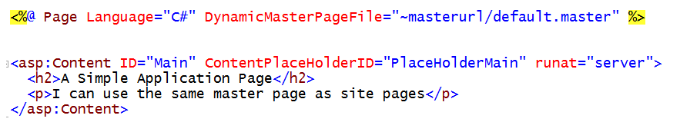
Linking Application Pages to Master Pages
Application pages can use token in SP 2010
Site pages and application pages use one master page
SP 2010 uses DynamicMasterPageFile attribute
Attribute is assigned same token
Notes:
One noteworthy improvement to the SharePoint 2010 user interface is that application pages can now link to master pages in the master page gallery. Many of the standard application pages that are included in Microsoft SharePoint Foundation 2010 and Microsoft SharePoint Server 2010 are initially linked to v4.master. The fact that sites pages and application pages can now be linked to a single master page creates a more uniform look and feel across all the pages in a site.
There is new syntax introduced in SharePoint 2010 that enables application pages to link to a master page by using the same dynamic token that is used by site pages. This syntax involves adding the DynamicMasterPageFile attribute in the Page directive, as shown in the slide above.
This syntax can be confusing at first because the DynamicMasterPageFile attribute is not recognized by the ASP.NET runtime. Instead, DynamicMasterPageFile is a custom attribute that is read and interpreted by SharePoint 2010 early in the page life cycle. Just as in the case of a site page, SharePoint 2010 is able to retrieve the MasterUrl property value for the current site and use it to dynamically link the application page to the correct master page.
The way that site pages and application pages link to a master page is different, but they both typically rely on the ~masterurl/default.master token to produce the same effect. This is what makes it possible to swap out the master page for every page in a SharePoint 2010 site simply by updating the SPWeb.MasterUrl property.

Slide 13
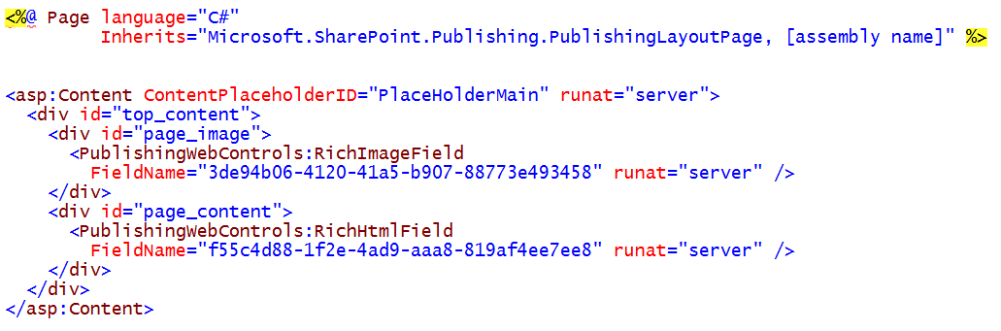
Linking Publishing Pages to Master Pages
Publishing pages have separate master page
Publishing pages inherit from PublishingLayoutPage
Publishing page base class inspects CustomMasterUrl
Same effect as token ~masterurl/custom.master
Notes:
There is one common scenario in both MOSS and SharePoint Server 2010 where the pages in a site do not link to the master page referenced by the MasterUrl property. This scenario involves publishing sites that contain a special document library named Pages. The Pages document library contains a special type of page known as a publishing page. All publishing pages dynamically link to a master page by using another property of the SPWeb class named CustomMasterUrl. Therefore, when writing code to swap out the master page in a publishing site, you are required to update the CustomMasterUrl property instead of, or in addition to, the MasterUrl property.

Slide 14
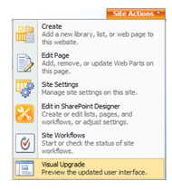
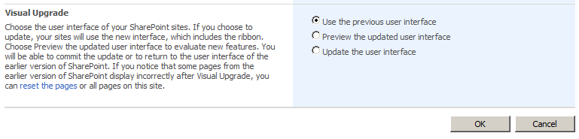
Switching Between UI Version Modes
When SP 2007 site is migrated to SP 2010 farm
Site gets an initial UIVersion property setting of 3
UIVersionConfigurationEnabled property is set to true
Site administrator can preview new SP 2010 UI
Site administrator can upgrade site to new SP 2010 UI
Notes:
By default, when a WSS site or an MOSS site is upgraded to SharePoint 2010, its pages are initially rendered by using the version 3 user interface of WSS. However, the choice of when to migrate the user interface to version 4 can be made by site administrators on a site-by-site basis by using standard commands in the browser. There is also a command available in the browser for a site collection owner to migrate all the sites within a site collection at one time. This means that individual teams can decide when the time is right for them to migrate the user interface of their sites to version 4.
SharePoint 2010 makes it possible to enable or disable the ability of a site administrator to reconfigure the user interface version. This control is made possible through another new SPWeb property, the UIVersionConfigurationEnabled property. If this property has a Boolean value of true, SharePoint 2010 provides the site administrator with the ability to move forward or move back between versions by using the browser. If a site has a UIVersionConfigurationEnabled property value of false, SharePoint 2010 does not provide the site administrator with any control to switch between the user interface versions.
Things are different when upgrading existing sites from WSS and MOSS. When you upgrade a site, SharePoint 2010 has the default behavior of initially assigning a UIVersion property value of 3 and a UIVersionConfigurationEnabled property value of true. This means that the user interface for upgraded sites initially runs under version 3. Upgraded sites also provide the site administrator with the ability to reconfigure the user interface for the site to begin using version 4. However, when a site administrator decides to reconfigure the site running under version 4, SharePoint 2010 updates the UIVersionConfigurationEnabled property to false, taking away the site administrator's ability to move back to version 3.

Slide 15
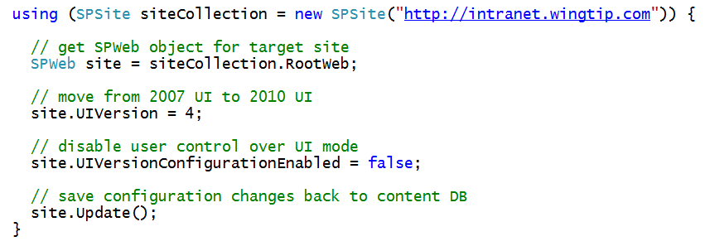
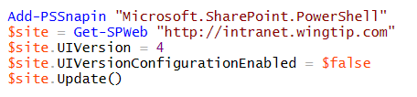
Updating a Site's UI Mode Using Code
Written in C# as part of SharePoint Solution
Windows PowerShell
Notes:
The server-side object model of SharePoint 2010 makes it relatively easy to update the UIVersion property of one or more sites to automate migrating the user interface of sites in a farm from version 3 to version 4. The simple C# code snippet in the slide above reconfigures a site to run under the version 4 user interface mode.
What if you are a farm administrator and you want to accomplish the same result without having to write a compiled component or application? You can write the equivalent code to update the UIVersion property of one or more sites by using a Windows PowerShell script. For example, what if you want to transition a single site that is currently running under version 3 to use version 4? You can write a Windows PowerShell script like the one shown in the slide above that creates an SPWeb object for the target site and updates the same properties as the C# code in the preceding example.
When you create a Windows PowerShell script in which you want to call cmdlets provided by SharePoint 2010, you should begin by calling the Add-PSSnapin cmdlet to load the Windows PowerShell snap-in that contains the SharePoint 2010 cmdlets. Then you can retrieve the target site object with the Get-SPWeb cmdlet to retrieve the target SPWeb object. After that, you can assign a value of 4 to the UIVersion property and a value of false to the UIVersionConfigurationEnabled property, followed by a call to Update, as shown in the example above.

Slide 16
DEMO
Changing the UI Mode of a SharePoint Site

Slide 17
Agenda
Motivation for Visual Upgrade
The Mechanics of Visual Upgrade
Updating Branding Assets for SharePoint 2010

Slide 18
SharePoint 2007 Branding Projects
What About SharePoint 2007 Branding Projects?
Unfortunately, they will not translate to SharePoint 2010
Custom CSS must be updated
Master pages should be created from scratch
Some older master page content can be copied
SharePoint 2007 themes must be refactored
Is this work required before migrating content?
No, thanks to Visual Upgrade in SharePoint 2010
Notes:
In addition to the need for users to get up to speed on the new user interface, there is also the issue of how to migrate branding projects, user page customizations and custom components that were designed and tested for WSS and MOSS.
Companies that have invested in SharePoint 2007 branding projects must revisit their work and make the modifications required to make the look and feel fit into the new model of the SharePoint 2007 user interface. This will always involve making updates to the custom CSS rules that were created to brand SharePoint 2007 sites. It will also frequently involve edits to master pages or even recreating master pages from scratch. Custom themes created for SharePoint 2007 cause a significant problem because they cannot be moved to SharePoint 2010. Therefore, the custom CSS rules and images created for a SharePoint 2007 theme have to be refactored into a format that works in SharePoint 2010.
Companies that are migrating sites that have customized pages or that rely on custom components such as Web Parts should take proactive steps to ensure that these page customizations and custom components appear and behave correctly when used in the new user interface of SharePoint 2010. In some scenarios, customized pages and custom solutions designed for WSS and MOSS might have to be updated before they work correctly in the new user interface.

Slide 19
Managing the Visual Upgrade Process
Migration aspects that must be managed
SharePoint 2007 branding projects
Customized page content
Custom components created in house
Custom components created by third party vendors
Notes:
When you begin migrating existing sites from WSS and MOSS to SharePoint Foundation 2010 and SharePoint Server 2010, you must be careful to consider what customizations have been applied. For example, did your company create custom branding solutions for SharePoint 2007 that must be updated to work correctly in SharePoint 2010. Are you upgrading sites in which users have customized pages with their own HTML by using MOSS? You must also consider whether any of the sites to be upgraded rely on custom SharePoint solutions created by your company's development staff or by third-party software vendors. For example, do the sites that you plan to upgrade rely on custom master pages or Web Parts that produce HTML that will not render correctly when they are hosted on a page that defines the XHTML Strict DOCTYPE? These are the types of issues that you must anticipate and be prepared to resolve when upgrading sites to SharePoint 2010.
Consider a scenario where the pages in a WSS site have been customized by users by using Office SharePoint Designer 2007. After this site is upgraded, you might find that these pages behave as expected because the pages are running under version 3. However, you might find that these same pages do not render correctly after the site administrator reconfigures the site to run under version 4. This section discusses some of the most common issues that you might encounter and how to resolve them.

Slide 20
Updating SharePoint 2007 Branding Projects
Existing files that must be edited
Custom CSS files
Master Pages and Page Layouts
Site Pages and Site Page Templates
Application Pages
Create master pages and CSS files from scratch
Do not try and simply edit files designed for SP 2007
Create skeleton using a SP 2010 starter master page
Copy-and-paste sections from older master pages
Copy-and-paste sections older CSS rules then update
Notes:
When it comes to updating a SharePoint 2007 branding project, there are quite a few existing files that must be edited. This included custom CSS files, custom master pages, page layouts, site pages and site page templates and application pages.
Given the significant number of changes between the user interface modes of SharePoint 2007 and SharePoint 2010, it usually doesn't make sense to attempt to edit the existing files to make the required changes. With master pages and CSS files it makes more sense to create them for the SharePoint 2010 branding projects from scratch using starter master pages such as the one created by Randy Drisgall that were discussed earlier in this course.
Once you have created and begun testing a minimal master page skeleton and its accompanying CSS rules, you might have success copying and pasting sections from custom master pages and CSS files created for SharePoint 2007.

Slide 21
Ensure Pages Use ~masterurl/default.master
Site pages should be updated if needed
Ensure there are not hardcoded links to master pages
If you see hardcoded master page links like this
Replace them with dynamic links like this
Notes:
When examining site pages and site pages templates, make sure they are using the dynamic token value of ~masterurl/default.master. Take note that this might not be the case for site pages that have been created or customized by using SharePoint Designer 2007.
You might find that some site pages in an upgraded site have a hardcoded link to default.master or some other custom master page instead linking using the dynamic token. This will cause problems because SharePoint 2010 relies on the dynamic token to redirect the master page link from default.master to v4.master when the site's UIVersion property is changed from 3 to 4. Therefore, you should update all site pages to link to a master page by using the token value of ~masterurl/default.master instead of a hardcoded path.

Slide 22
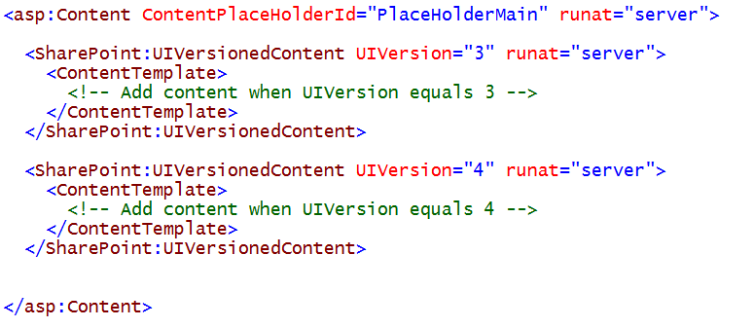
Refactor HTML into v3 and v4 Sections
Done using UIVersionedContent control
Use to add version-specific HTML, CSS and JavaScript
Can be used in master pages and page layouts
Can be used in site pages and application pages
Notes:
When you reconfigure the user interface for a site from version 3 to version 4, two important changes usually occur that can affect how HTML is rendered. First, the master page changes from default.master, which has no DOCTYPE, to v4.master, which has an XHTML DOCTYPE of Strict. The second thing that happens is that SharePoint 2010 switches out the primary .css file link from core.css to corev4.css. Both of these changes have the ability to make HTML layouts designed for WSS and MOSS render incorrectly when running under version 4.
When you find that customized site pages or customized master pages contain HTML fragments that do not properly render properly under version 4, you can factor this HTML out into separate sections for version 3 and version 4. This can be accomplished by using the UIVersionedContent control that is introduced in SharePoint 2010.

Slide 23
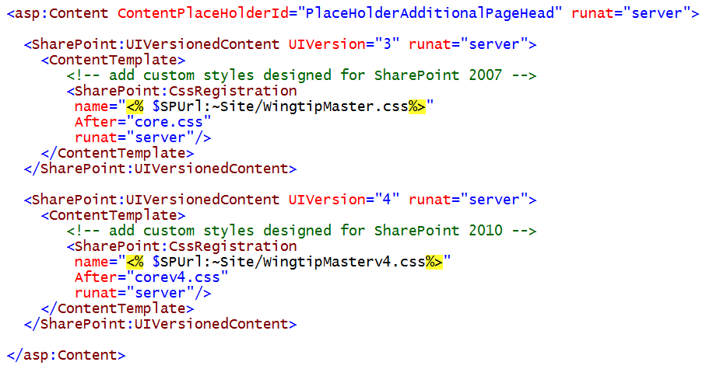
Refactoring CSS Rules into Separate Files
Notes:
Due to the fact that pages in a SharePoint site use a different DOCTYPE for version 3 and version 4, a single set of cascading style sheets rules will not produce consistent results when used across both version 3 and version 4. Furthermore, the HTML element IDs and cascading style sheets class names that must be referenced by cascading style sheets rules vary between the default.master and v4.master files.
It makes sense to factor cascading style sheets rules into separate files for version 3 and version 4. For example, let's say that you are upgrading a site that has a custom .css file named WingtipStyles.css. The recommended approach is to create a new .css file (or make a copy of the existing file) and name it WingtipStylesv4.css. This provides you with the ability to maintain separate sets of cascading style sheets rules for version 3 and version 4. You can then link to the appropriate .css file by using two UIVersionedContent controls, as shown in the following example.

Slide 24
Update Custom Application Pages
They should use dynamic token
They should not be hardcoded to application.master
If you see hardcoded master page links like this
Replace them with dynamic links like this
Notes:
SharePoint 2010 enables application pages to link to a master page by using the same dynamic token as site pages. However, this capability did not exist in WSS or MOSS. Therefore, most of the custom applications pages designed for WSS and MOSS have hardcoded links to master pages within the LAYOUTS directory, such as application.master.
When an application page that links to application.master runs under version 3, it behaves as you would expect. The application page links to the application.master file deployed by SharePoint 2010, which has the same HTML layout as the application.master file deployed by WSS. However, SharePoint 2010 is designed to add some special processing logic when the same page runs under version 4. When an application page that links to application.master runs under version 4, SharePoint 2010 dynamically changes the application page to link to a different master page named applicationv4.master, which has a DOCTYPE and HTML layout very similar to v4.master. This enables these older application pages to render by using the new SharePoint 2010 page layout.
Although this behavior of SharePoint 2010 to redirect application pages from application.master to applicationv4.master is useful, it is still not an optimal solution. If you use a custom branding solution that updates the MasterUrl property, application pages that link to application.master will not be redirected to use the same master pages as the other pages in the site. The same problem exists if you try to change the master page that is used by a publishing site. The way to resolve this problem is to update the Page directive of any master page that directly links to a master page in the LAYOUTS directory. You should remove the MasterPageFile attribute from the Page directive and replace it with the DynamicMasterPageFile attribute.

Slide 25
DEMO
Versioning Page Content with a UIVersionedContent Control

Slide 26
Summary
Motivation for Visual Upgrade
The Mechanics of Visual Upgrade
Updating Branding Assets for SharePoint 2010

